Slide 1
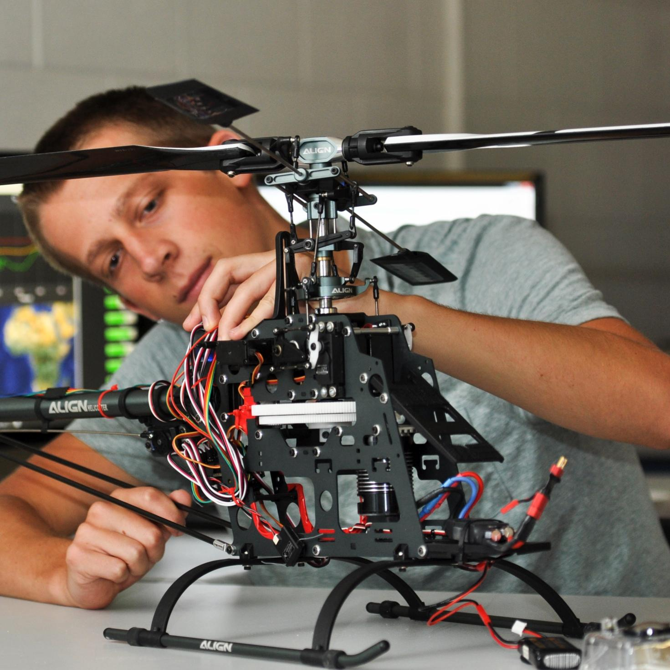

Team 27: Personalized Financial Advisor App for Students
Bi-Weekly Update 3
Camille Embree, Hoang-Nghi Nguyen
TA: Sabyasachi Gupta

Slide 2

Project Summary
Financial management is difficult for many students, with irregular income, high living expenses and a general lack of tools and the incentive to provide clear visibility on personal spending.
Our app addresses this by using AI and machine learning to work with transaction tracking through categorization and personalized financial feedback.

Slide 3
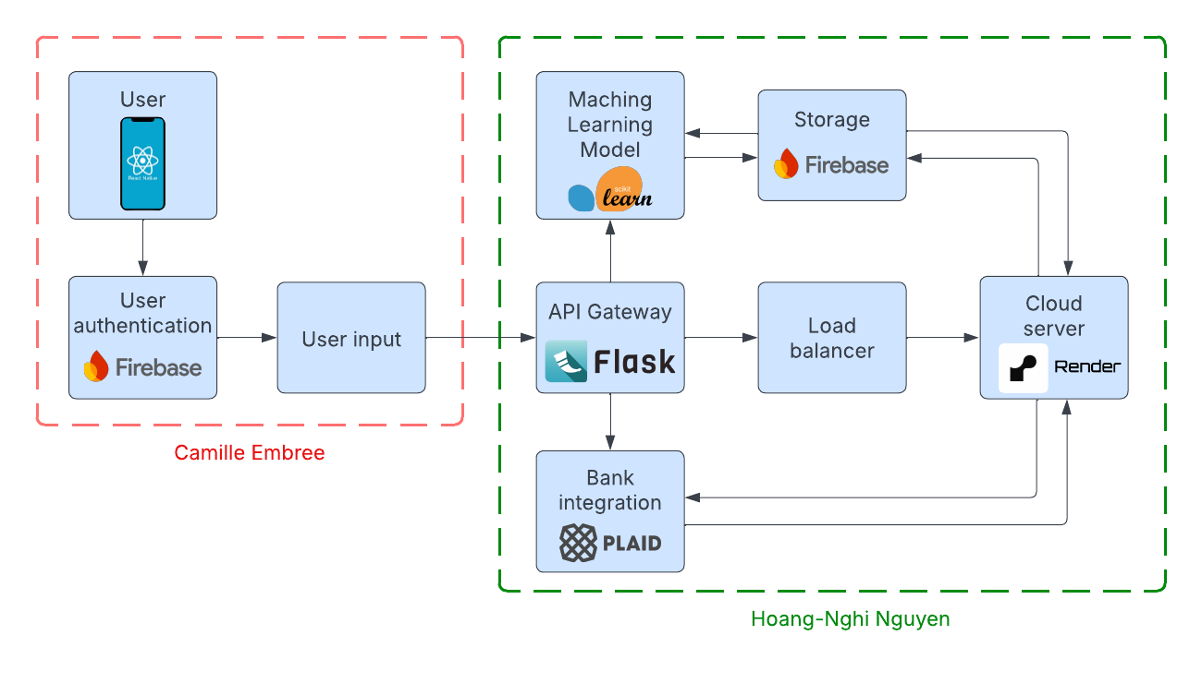
Project/Subsystem Overview

Slide 4
Adaptive Gamified Learning
Purpose: Make financial learning engaging while adapting advice and challenges based on each user’s spending behavior
How it works:
Data-Driven Personalization
  ML model for trend analysis in user transactions
  Forecasting for future spending prediction overall and per category of user expenses
Adaptive Feedback Loop
  User actions -> Financial Feedback -> Performance metrics -> Challenge updates
Learning Impact
  Encourages consistent budgeting behavior
  Assists in building financial literacy in real-time without deterring users from being proactive with their spending

Slide 5
Project Timeline
Database and Plaid API testing (completed 9/18) | Polished application pages (to be completed | Plaid API integration (to complete by 9/25) | Final Integration (to complete by 10/15) | System Test (to complete by 11/2) | Validation (to complete by 11/26) | Demo and Report (to complete by 12/5)

Slide 6
Subsystem 1
Camille Embree
Accomplishments since last update 21 hrs of effort | Ongoing progress/problems and plans until the next presentation
Updated Firestore database to reflect trivia mini-game Created drafts of new quiz tab and mini-game | Test front-end/back-end database integration Create quizzes tab page Create two more mini-games for implementation

Slide 7
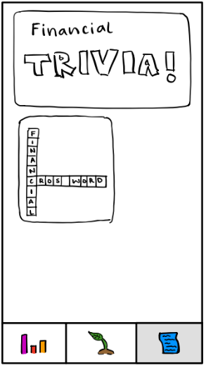
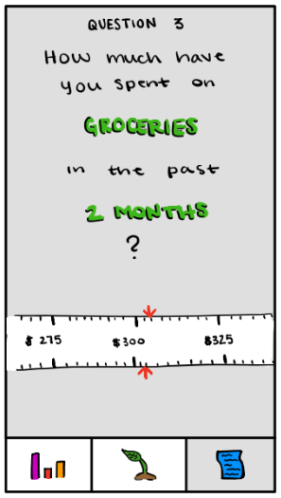
UI Design

Slide 8
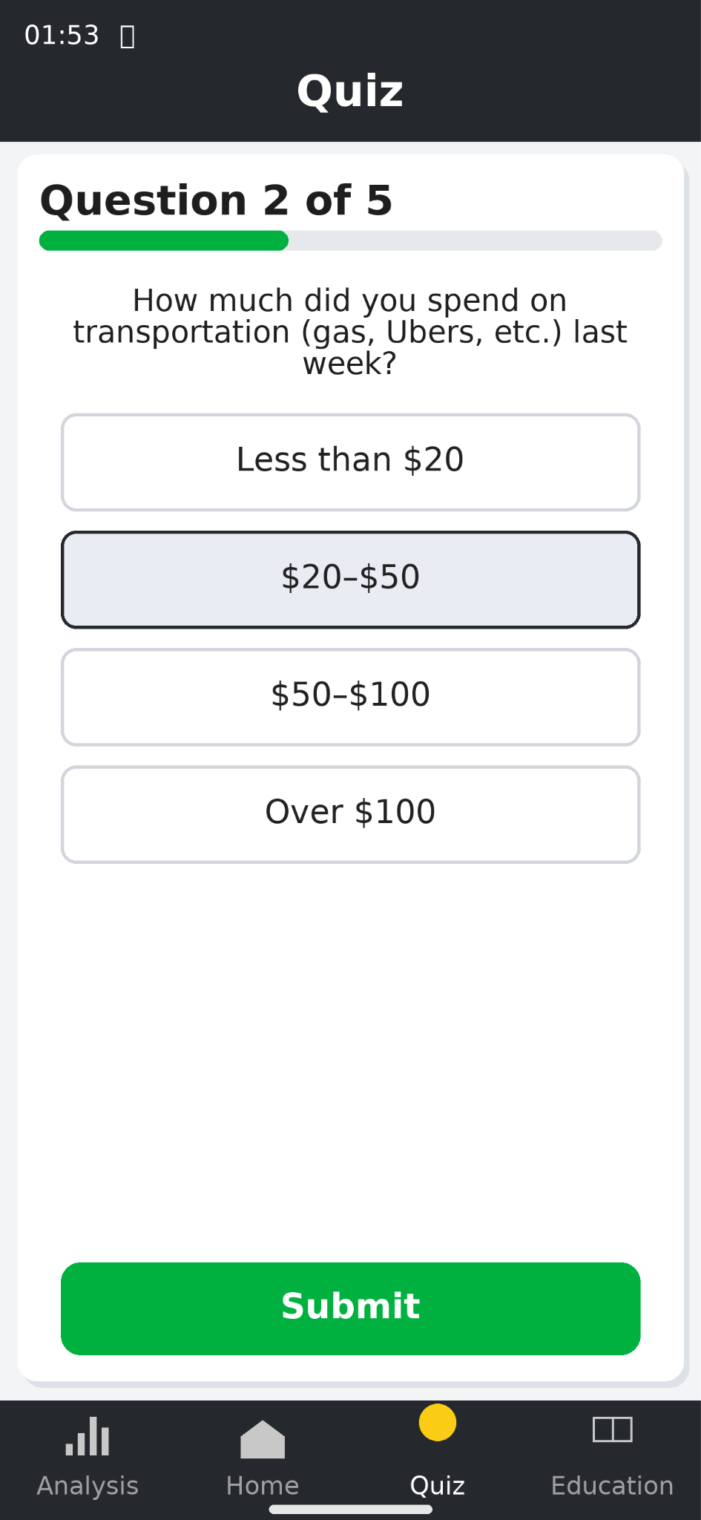
UI Design

Slide 9
Subsystem 2
Hoang-Nghi Nguyen
Accomplishments since last update 35 hrs of effort | Ongoing progress/problems and plans until the next presentation
Plaid API Integration finalized. | Backend design for resource forecaster ML model. Designing and creating structure and pipeline for financial minigames.

Slide 10
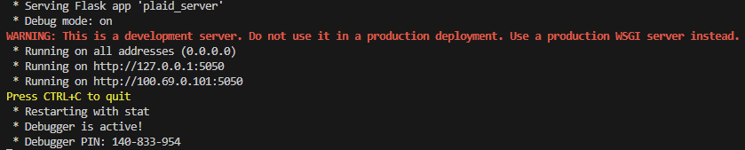
Subsystem 2

Slide 11
Execution Plan
 | 8/31/25 | 9/7/25 | 9/14/25 | 9/21/25 | 9/28/25 | 9/31/25 | 10/5/25 | 10/12/25 | 10/19/25 | 10/26/25 | 11/2/25 | 11/9/25 | 11/16/25
Solidify Database Organization
Plaid API Sandbox Testing |  |  |  |  |  |  |  |  |  |  |  | Not started
Make UI More Relaxing |  |  |  |  |  |  |  |  |  |  |  | In Progress
Implement Breathing Animation |  |  |  |  |  |  |  |  |  |  |  | Completed
Plaid API Integration |  |  |  |  |  |  |  |  |  |  |  | Behind Schedule
Integrate Joint Database
Frontend-Backend API Connection
ML Forecaster Design
Backend Financial Minigame Design
Frontend Minigame UI Page Design

Slide 12
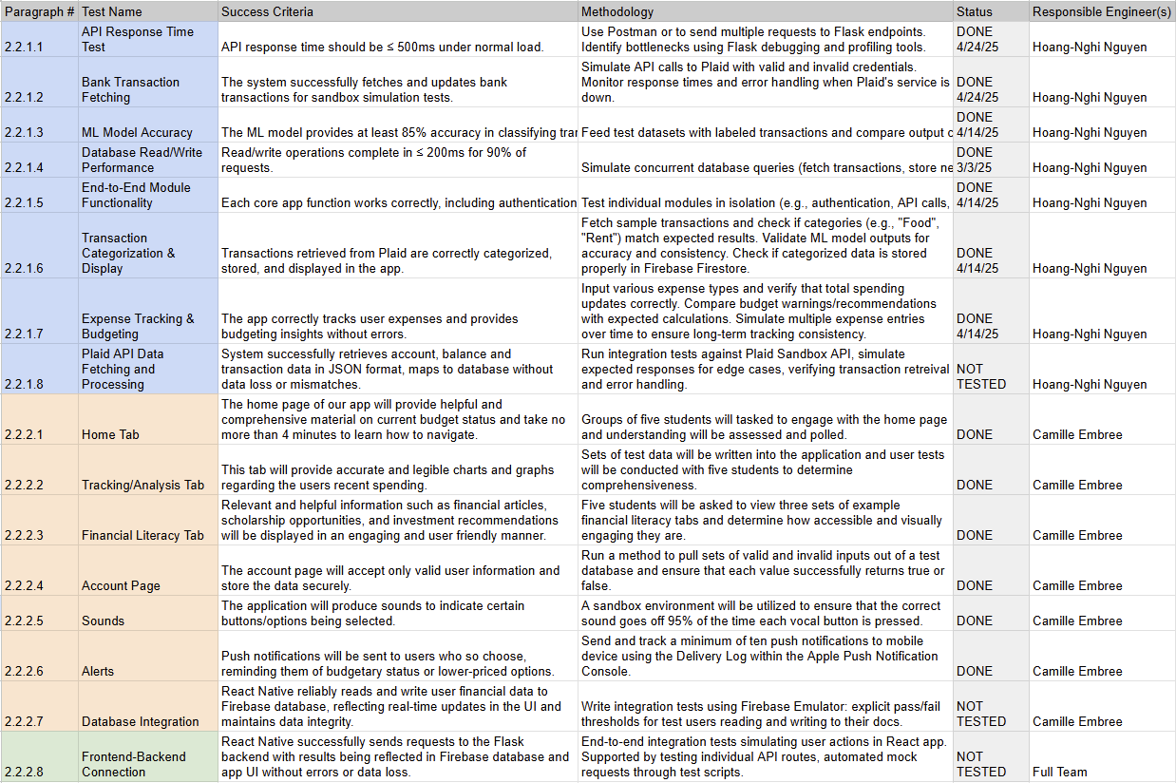
Validation Plan

Slide 13
Thank you

